Slide 1

澳洲华人工信联盟 第二次聚会

Slide 2
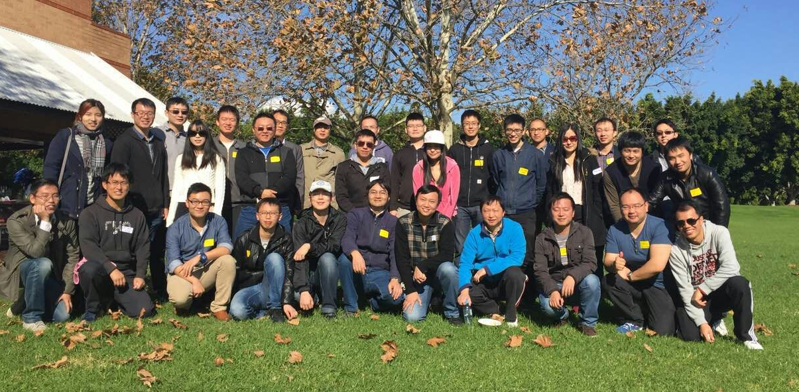
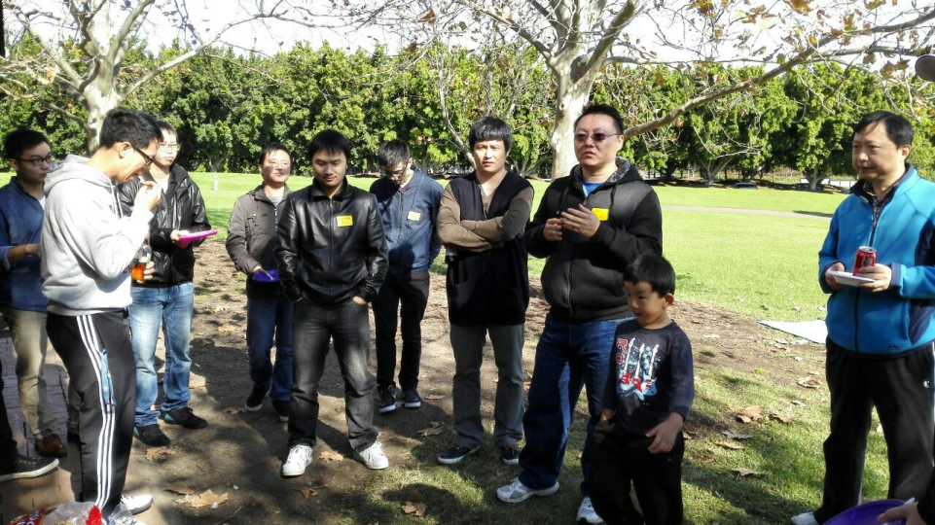
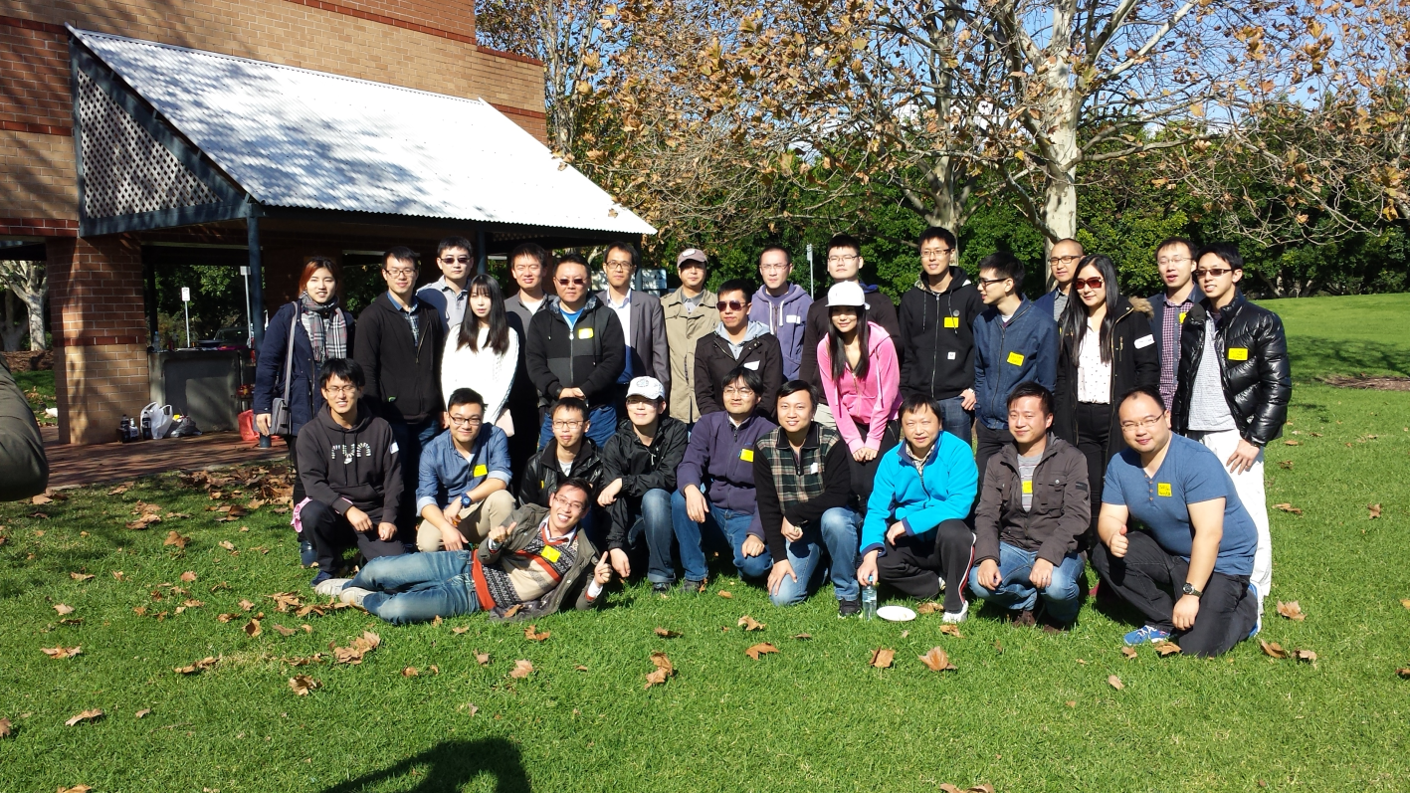
上期回顾☺ BBQ+ networking, 24/05/15

Slide 3
聚会流程
开场致词 (10’) Raymond
ACEIA的宗旨及发展方向,活动板块 (10’) Raymond
本次技术话题1： DevOps (30’) Jack
break
求职技巧探讨 (30’) LING
本次技术话题2： Internet of Things (30’) Jeff
break
相关职位推荐及分析 (CBA, Optus, M2, etc) (20’) LING/Andrew/Raymond
本次技术话题3: Java 8 and beyond (30’) Eric
break
ACEIA核心团队搭建意向：介绍工信群组建核心团队的想法及计划，人才吸引及技能要求。(15’) LING
介绍ACEIA和K-Evolution 长期合作的计划: 介绍K-Evolution, 双方优势及互补分析，近期社会活动 (20’) Ken (MIMO)
Q&A , Networking (20’)

Slide 4
聚会主题
ACEIA的宗旨及发展方向,活动板块
本期技术话题1： DevOps (Jack Tan)
本次技术话题2： Internet of Things (Jeff Chen)
本次技术话题3: Java 8 and beyond (Eric Li)
求职技巧探讨 (Ling Yi)
相关职位推荐及分析 (M2, Optus, etc) (LNG/Andrew/Raymond)
ACEIA核心团队搭建意向：介绍工信群组建核心团队的想法及计划，人才吸引及技能要求 (LING YI)
介绍ACEIA和K-Evolution 长期合作的计划: 介绍K-Evolution, 双方优势及互补分析，近期社会活动 (Ken from E-Evolution)

Slide 5






ACEIA的宗旨及发展方向
宗旨：为在澳洲以理工，IT为背景的华人提供一个
信息交流，资源共享，人脉拓展的平台
发展方向:
1. 为有相同技术背景刚来澳洲或正在求职的
朋友提供就业咨询和行业讯息，为毕业生
提供就业指导，为广大群成员分享多个
领域的信息和知识
2. 寻求组织内成员间，本组织和其他组织间的
商业，项目发展合作的 机会，共赢互惠

Slide 6
活动板块
技术论坛
邀请各领域资深技术人士分析行业发展趋势，和当前技术热点。
项目研讨
讨论内部孵化和外接项目的技术和市场可行性
就业指导，职位信息交流
不定期指导如何寻工，面试的技巧
各个成员就业公司现有职位，讨论匹配性。大学生可以进行现场匹配阐述。
Mentoring Program

Slide 7
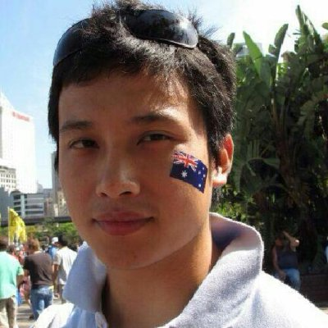
技术话题 1 DevOps – Jack Tan CBA Cloud DevOps Engineer ACEIA Co-founder
Cloud Devops Engineer
Commonwealth Bank
August 2014 – Present (1 year)
Senior Devops Engineer
TrueLocal
August 2013 – August 2014 (1 year 1 month)
Cloud DevOps Engineer
PolarSeven
January 2013 – December 2013 (1 year)
Senior System Administrator /
Unix Operation Team Leader
News Corp Australia
July 2011 – August 2013 (2 years 2 months)
(Partially from LinkedIn)

Slide 8
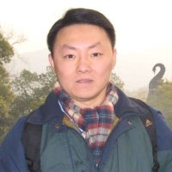
Job Hunting Techniques Discussion - 求职技巧探讨 LING YI M2 IP Core Manager South Fusion CEO ACEIA Co-founder
Way To Success
July – 2015
澳洲华人工信联盟- ACEIA 合作伙伴
southfusion.com.au – 南方复兴

Slide 9
求职中常遇到的问题：
工作经验不足
猎头不回应
缺少说服力的履历
面试紧张
英语表达能力
面试问题不知道如何回答

Slide 10
Topics
Job Selection
CV/ Resume
Cover Letter
Prepare for the Agent’s call
First Interview
Follow-up letter
Second Round Interview
Employer's perspective

Slide 11
Upcoming Course
下次培训课程
两周后
六小时
网上注册
公司工作经验职位，欢迎询问。

Slide 12
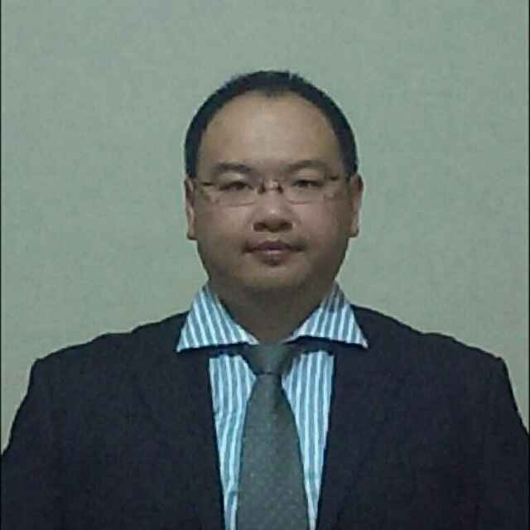
技术话题 2 Internet of Things - Jeff Chen
Verizon Australia – Professional Services Consultant
Aug 2010 – Present
Major Client:
Commonwealth Bank of Australia – Infrastructure Designer
Oct 2011 – Present
BT - British Telecom Australia - IP Support Analyst
Jun 2008 – Aug 2009
Reuters Australia – Network Distribution Management Specialist
Sep 2006 – May 2008
U Tech Media Australia – System and Network Engineer
Mar 2004 – Sep 2006
Australia Skynet - Customer Service Representative
Jul 2003 – Dec 2003

Slide 13
相关职位推荐及分析
职位1 (M2) Sales Assistant - Retail Kiosks - NSW
About the role We need energetic, self-driven and outgoing sales professionals who can create opportunities to sell Dodo’s products and services to new and existing customers.
With a proven track record in sales you will be able to assess individual customers' telco & utilities needs and provide a service focused solution.
You will need
A bright, friendly, and professional demeanour – we expect you are a people person!
The ability to actively engage people in conversation in a shopping centre environment
A confident sales approach to consistently identify needs and close sales
The ability to understand and communicate complex information in a simple way
Immaculate personal presentation
A brilliant customer service focus at all times – help us to make our customers happy
A minimum of 12 months experience in a successful sales role (ideally in a Retail environment)
For permanent roles, you need to be able to work 38 hours per week including weekends

Slide 14
相关职位推荐及分析
职位2 Technical Business Analyst
The department manages reporting platforms on behalf of their customers. Their reporting suite incorporates Sales and Service / product sales and income reporting, revenue and balance reporting. They are the conduit between the business unit Finance and Support teams and the wider Business Reporting Solutions team and their suppliers for all matters relating to Financial Performance Reporting. You will be responsible for:
Participating in workshops with business to elicit a common understanding of requirements and scope of work
Analysing and documenting functional processes and requirements
Providing support and participate in testing activities including system testing and user acceptance testing
Developing and deliver effective communication materials for various audiences
Identifying root cause and assisting in resolving issues and engage with stakeholders on resolution
To be successful, you will have:
An IT or business qualification
Strong business analysis or process improvement experience
Experience working on technology enabled projects
Sound knowledge of GDW, especially with regards to financial data and common layers
Proficiency with SQL

Slide 15
相关职位推荐及分析
职位3 (Optus) Web Software Engineer （EOI）
Working closely with Application Architects, Solution designers, senior developers, product, UX designers and Business Analysts, our developers take technical ownership of the products they build and deliver in the Online Technology space at Singtel Optus. They build the portals, mobile applications, and the services to support these, both from a function and a non-functional point of view.
Requirements:
You are a specialist is at least one programming language, but you have a broad background in software development, and have decent skills in several languages and platforms.
You know at least some jQuery, HTML 5 and CSS3
You have written some Android or IOS mobile applications
You can talk about web applications, have played with Angular, Backbone, node,js, Ruby on Rails, Akka, and other modern technologies.
You know how to use RESTful services, and you understand the job of a service.
You can program in Java and know what a WSDL is and what the meaning and purpose of SOA is.
You know what a CMS is.
You have experience with Amazon Web Service, or have at least played around with it and read up on it
You have knowledge or experience of agile environments, and have done test driven development.

Slide 16

技术话题 3 Java 8 & beyond - Eric Li Cloud Infrastructure Architect (News Corp Australia)
Cloud Infrastructure Architect
News Corp Australia
May 2015 – Present (3 months)
Founder / Architect / Developer
Hubound
January 2014 – Present (1 year 7 months)
Technical Lead
TrueLocal.com.au
February 2011 – April 2015 (4 years 3 months)
Doctor of Philosophy (PhD) in Computer Science (2010)
Murdoch University, Western Australia.
(Partially from LinkedIn)
http://ezza.me

Slide 17
ACEIA核心团队搭建意向

Slide 18
ACEIA核心团队搭建意向
技术部成员:
1. 精通某个或多个领域行业信息及技术，有团队领导经验针对不同项目进行初步分析，提出所需资源，培训技术团队成员，参与，指导项目的完成。
2. 具有相关专业背景的在读学生及毕业生，通过有经验的成员带领完成项目得到实战锻炼和技能提高。
外事发展部成员：进行项目对接，财务预算，对外合作；有技术，销售，财务方面的相关知识及一定的人脉关系。
活动协调部成员：负责工信群定期活动的协调和组织，网站搭建和品牌宣传，整理群内部资料及会议记录等任务。

Slide 19
荣誉主席
在某代表领域具有突出贡献及成绩，本群对外的最高荣誉象征
习江涛教授
Head of School of Electrical, Computer and Telecommunications Engineering at University of Wollongong
Professor, Head of School of Electrical, Computer and Telecommunications Engineering
University of Wollongong
June 2011 – Present (4 years 2 months)Wollongong Area, Australia
Professor
University of Wollongong
July 2010 – Present (5 years 1 month)Wollongong Area, Australia
Associate Professor
University of Wollongong
January 2006 – June 2010 (4 years 6 months)Wollongong Area, Australia
Senior Lecturer
University of Wollongong
January 2003 – December 2005 (3 years)Wollongong Area, Australia
CTO
TCL IT Group Co. Ltd
November 2000 – November 2002 (2 years 1 month)Shenzhen, China
（部分摘自于LinkedIn)

Slide 20


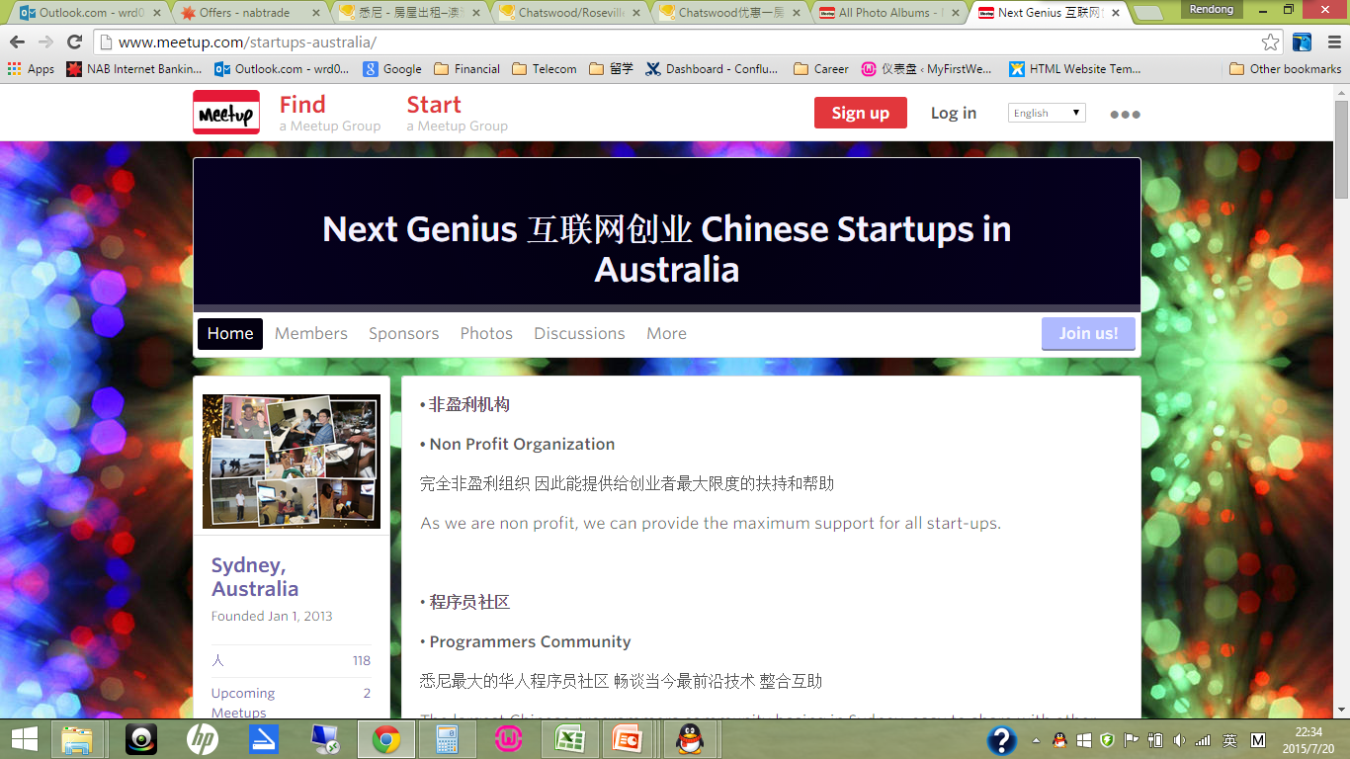
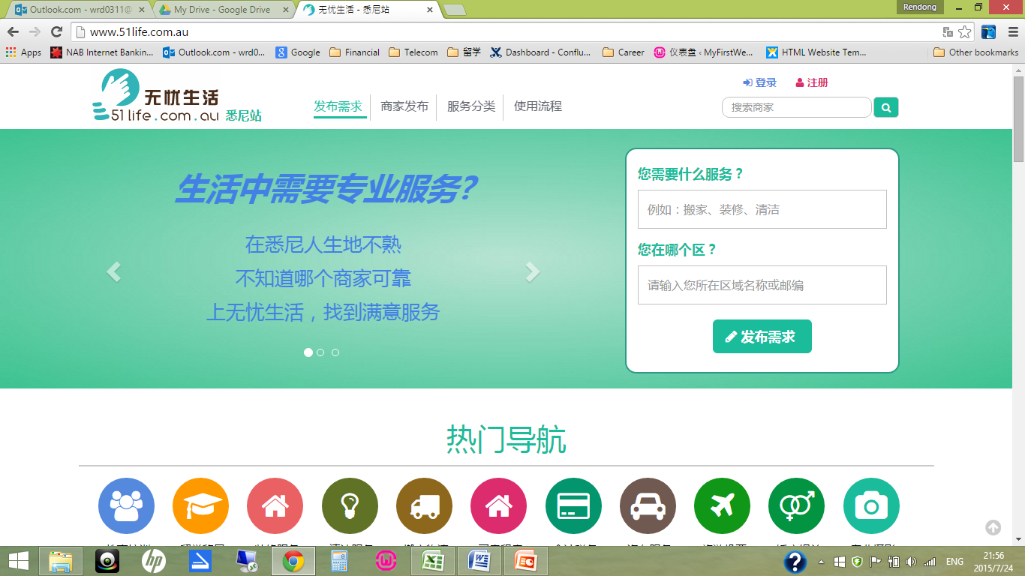

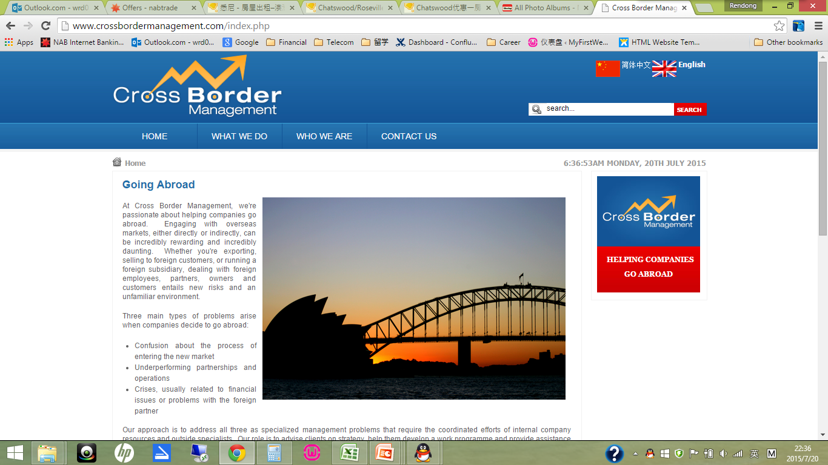
ACEIA 合作伙伴

Slide 21

ACEIA和K-Evolution 长期合作计划

Slide 22

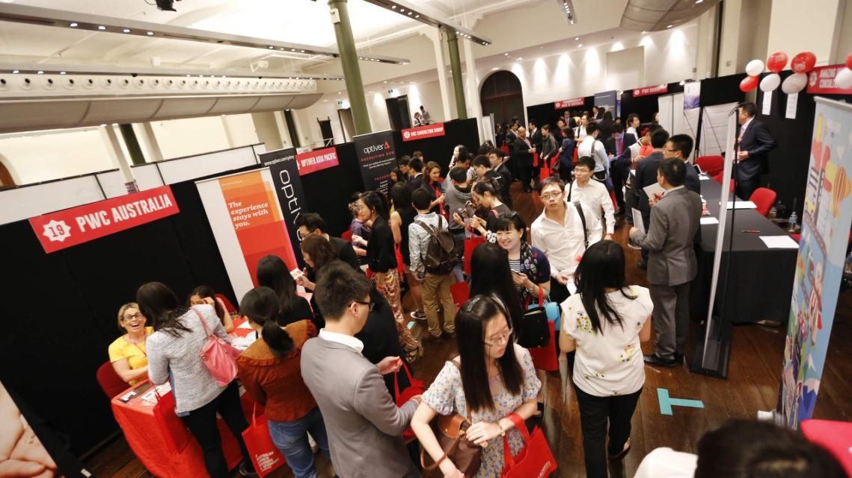
ACGI EXPO 2015年澳大利亚华人学生招聘展
Warm-up Seminar （end of Aug）
工程IT学生专场
ACGI Job Expo 28/09/2015
-ACEIA的参与
http://acgiexpo.com.au/

Slide 23
Q&A Networking

